Slide 1
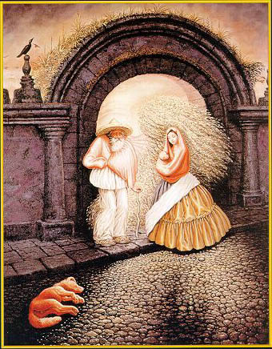
Grouping and Segmentation

Slide 2
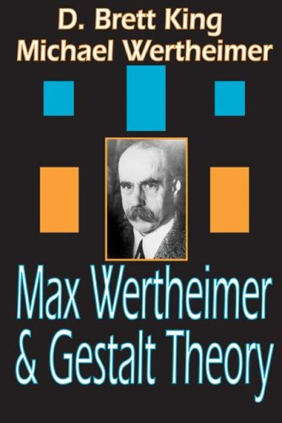
Gestalt psychology or gestaltism
German: Gestalt - "form" or "whole”
Berlin School, early 20th century
Kurt Koffka, Max Wertheimer, and Wolfgang Köhler
View of brain:
whole is more than the sum of its parts
holistic
parallel
analog
self-organizing tendencies
Slide from S. Saverese

Slide 3
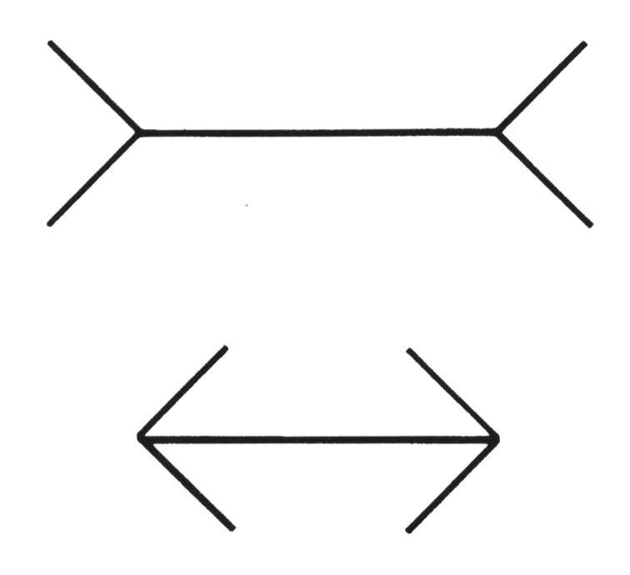
Gestaltism
The Muller-Lyer illusion
Notes:
The famous Muller-Lyer illusion; the point is that the horizontal bar has properties that come only from its membership in
a group (it looks shorter in the lower picture, but is actually the same size) and that these properties can’t be discounted--- you can’t look at this figure and ignore the arrowheads and thereby make the two bars seem to be the same size.

Slide 4
We perceive the interpretation, not the senses
Notes:
In one experiment, children from rural Zambia were less susceptible to the illusion.

Slide 5
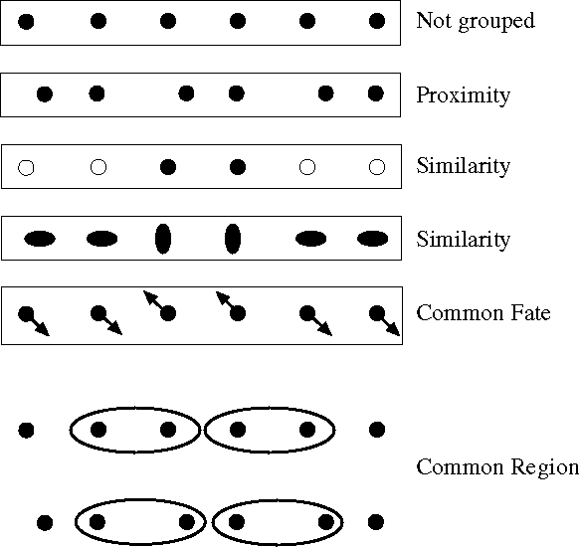
Principles of perceptual organization
From Steve Lehar: The Constructive Aspect of Visual Perception
Notes:
Some criteria that tend to cause tokens to be grouped.

Slide 6
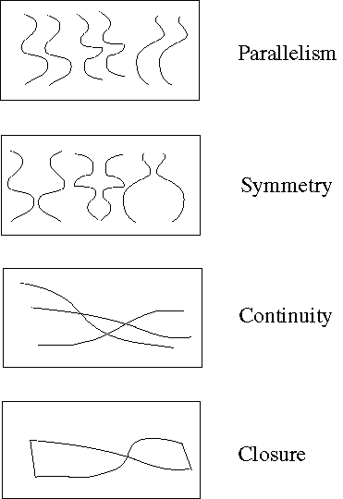
Principles of perceptual organization
Notes:
More such

Slide 7
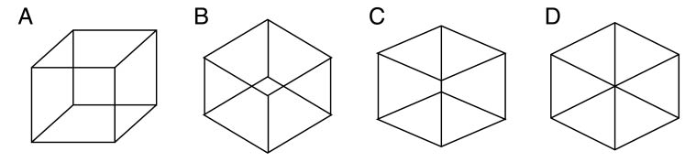
Gestaltists do not believe in coincidence

Slide 8
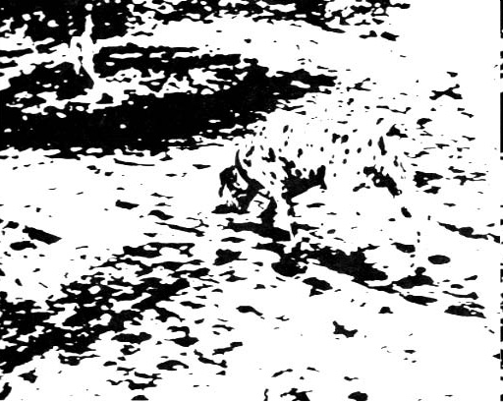
Emergence

Slide 9
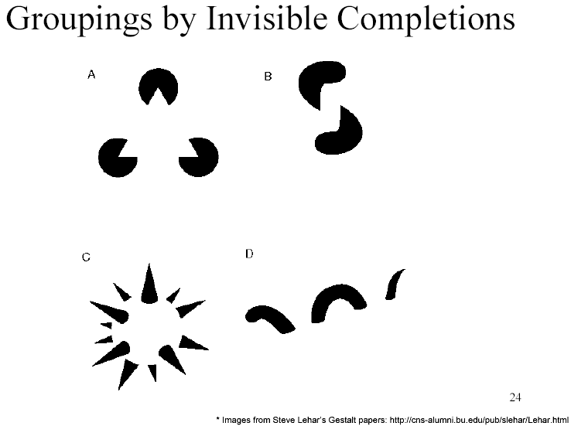
Grouping by invisible completion
From Steve Lehar: The Constructive Aspect of Visual Perception

Slide 10
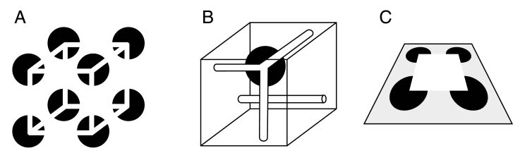
Grouping involves global interpretation
From Steve Lehar: The Constructive Aspect of Visual Perception

Slide 11
Gestalt cues
Good intuition and basic principles for grouping
Basis for many ideas in segmentation and occlusion reasoning
Some (e.g., symmetry) are difficult to implement in practice

Slide 12
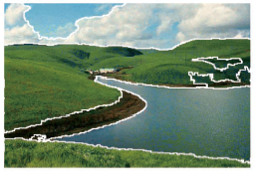
Image segmentation
Goal: Group pixels into meaningful or perceptually similar regions

Slide 13
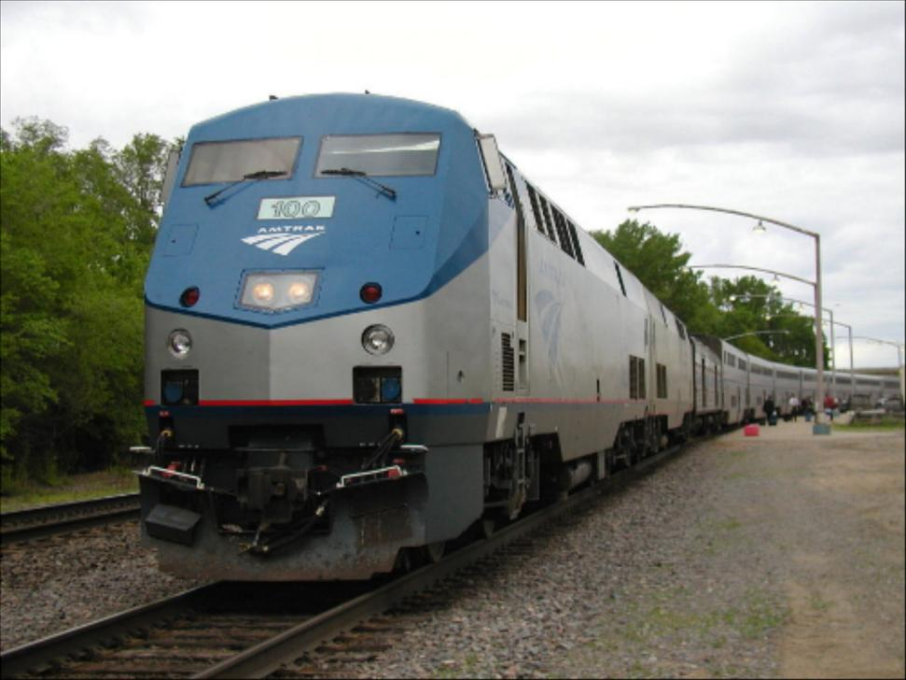
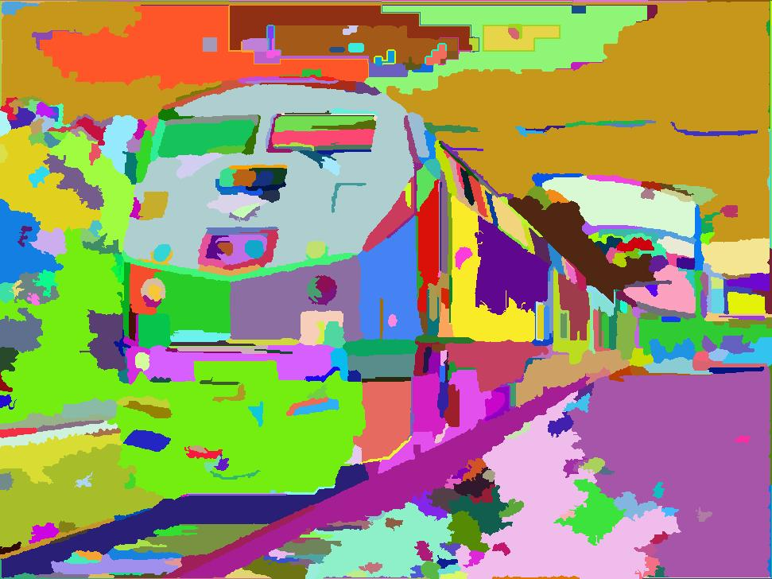
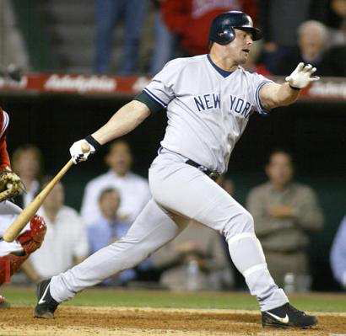
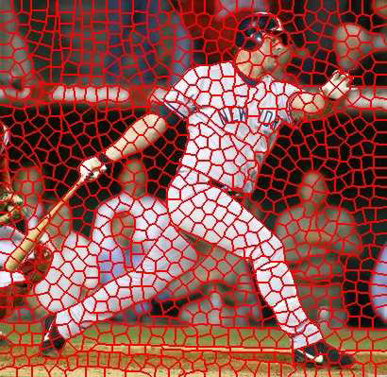
Segmentation for efficiency: “superpixels”
[Felzenszwalb and Huttenlocher 2004]
[Shi and Malik 2001]
[Hoiem et al. 2005, Mori 2005]

Slide 14
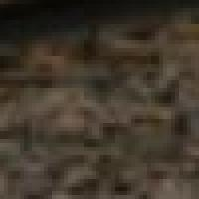
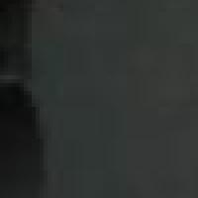
Segmentation for feature support
50x50 Patch
50x50 Patch

Slide 15
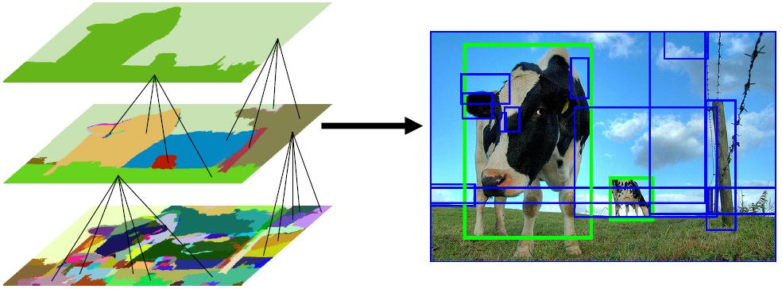
Segmentation for object proposals
“Selective Search” [Sande, Uijlings et al. ICCV 2011, IJCV 2013]
[Endres Hoiem ECCV 2010, IJCV 2014]

Slide 16
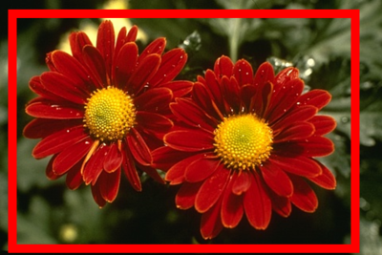
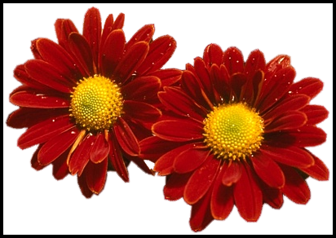
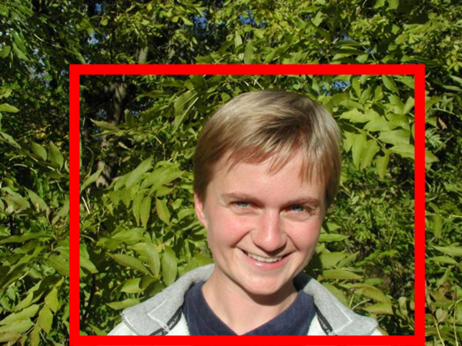
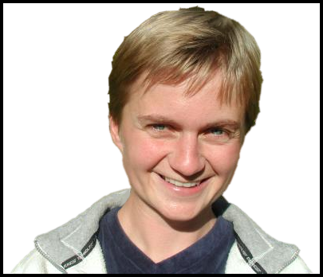
Segmentation as a result
Rother et al. 2004

Slide 17
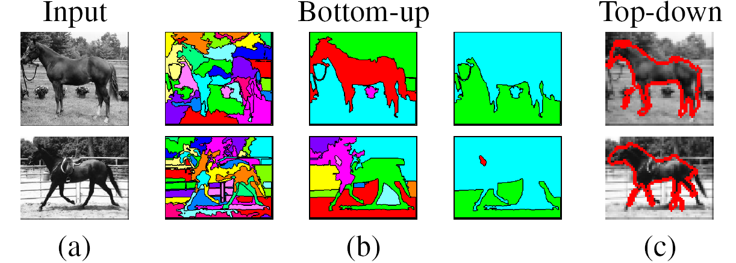
Types of segmentations
Oversegmentation
Undersegmentation
Multiple Segmentations

Slide 18
Major processes for segmentation
Bottom-up: group tokens with similar features
Top-down: group tokens that likely belong to the same object
[Levin and Weiss 2006]

Slide 19
Segmentation using clustering
Agglomerative Clustering
Kmeans

Slide 20
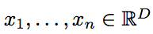
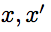
Clustering: distance measure
Clustering is an unsupervised learning method. Given items , the goal is to group them into clusters. We need a pairwise distance/similarity function between items, and sometimes the desired number of clusters.
When data (e.g. images, objects, documents) are represented by feature vectors, a commonly used similarity measure is the cosine similarity. Let be two data vectors. There is angle between the two vectors .

Slide 21
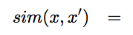
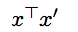
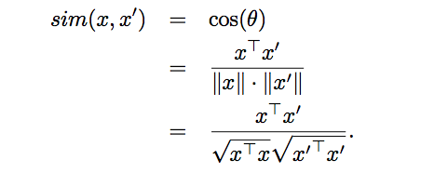
Defining Distance Measures
Let x and x’ be two objects from the universe of possible objects. The distance (similarity) between x and x’ is a real number denoted by sim(x, x’).
The euclidian similarity is defined as
In contrast, cosine distance measure would be

Slide 22
Desirable Properties of a Clustering Algorithms
Scalability (in terms of both time and space)
Ability to deal with different data types
Minimal requirements for domain knowledge to determine input parameters
Interpretability and usability Optional
Incorporation of user-specified constraints

Slide 23
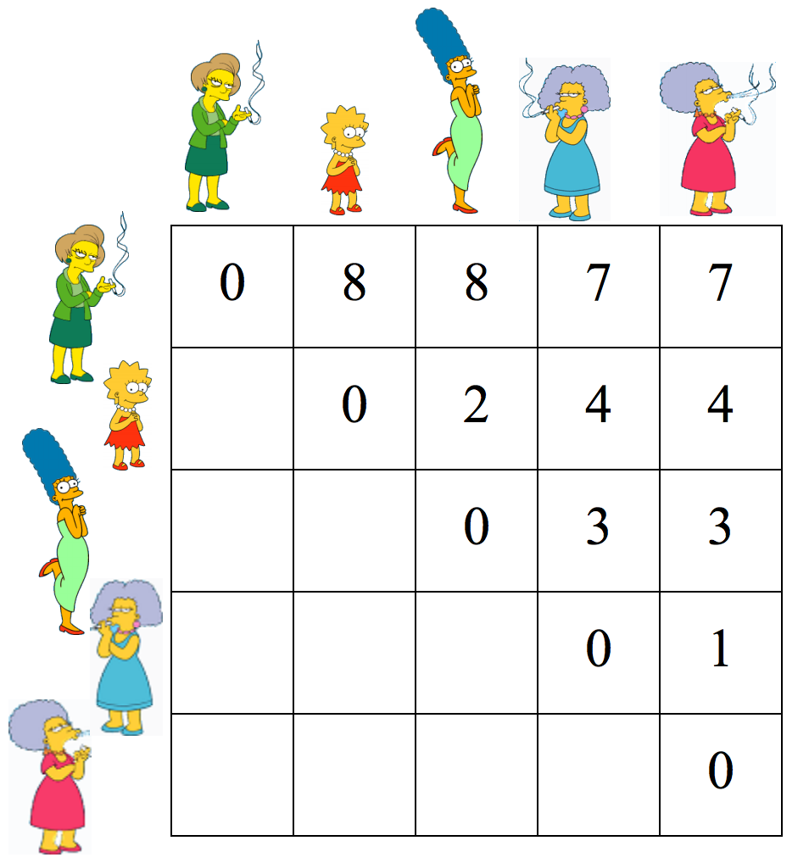
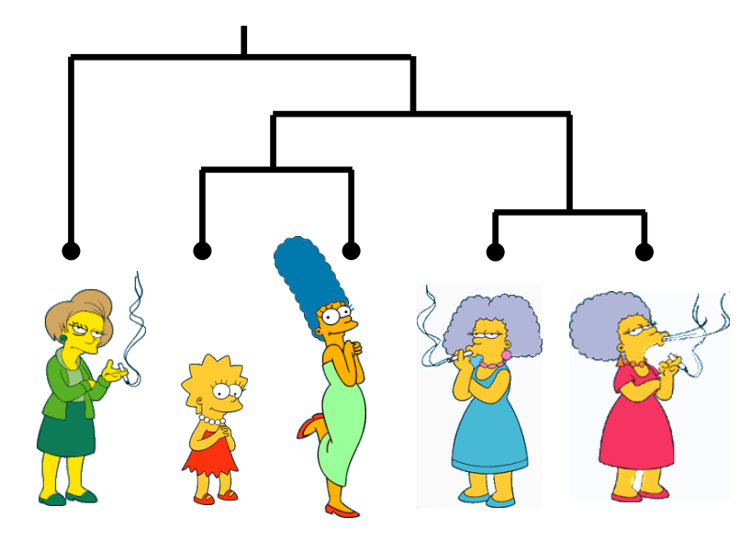
Animated example
source

Slide 24
Animated example
source

Slide 25
Animated example
source

Slide 26
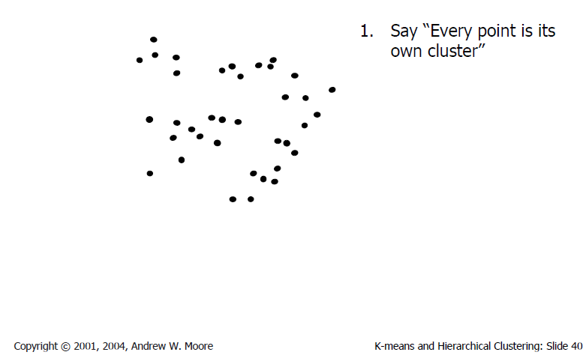
Agglomerative clustering
Slide credit: Andrew Moore

Slide 27
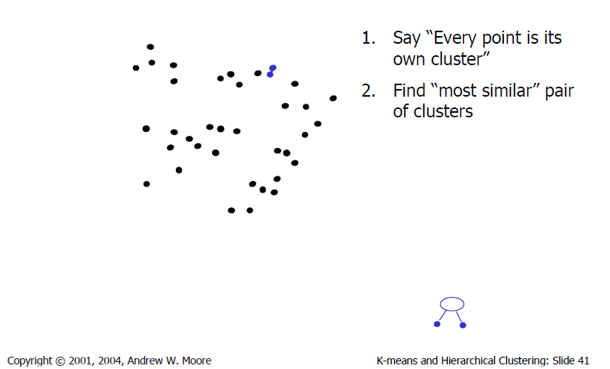
Agglomerative clustering
Slide credit: Andrew Moore

Slide 28
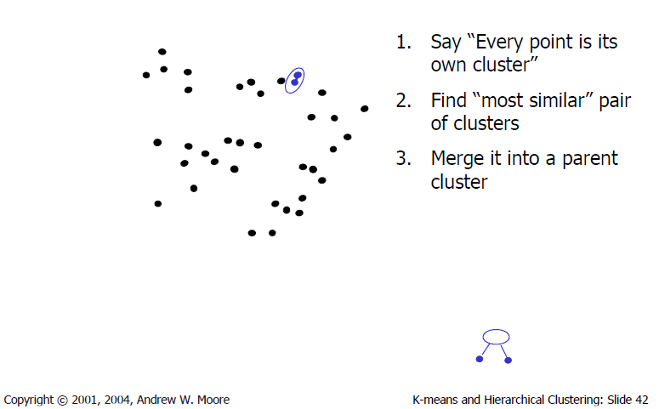
Agglomerative clustering
Slide credit: Andrew Moore

Slide 29
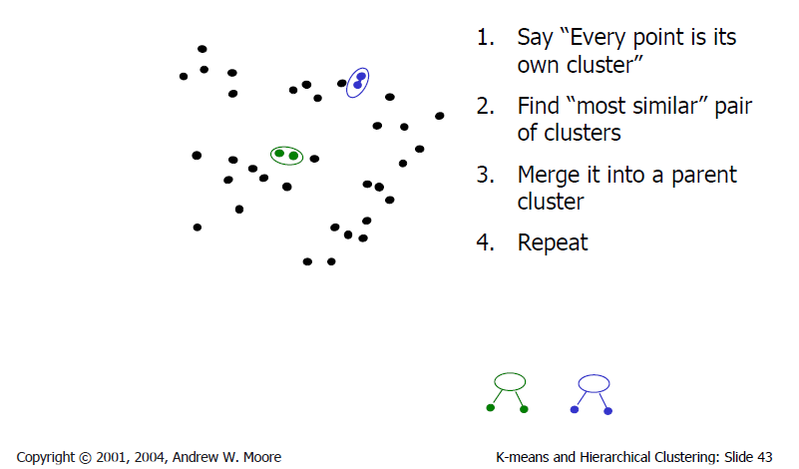
Agglomerative clustering
Slide credit: Andrew Moore

Slide 30
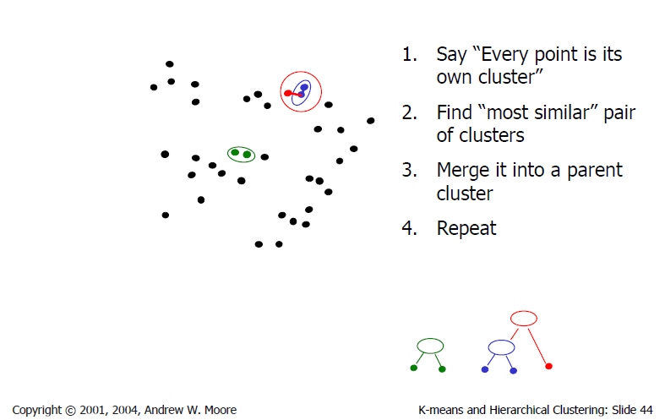
Agglomerative clustering
Slide credit: Andrew Moore

Slide 31
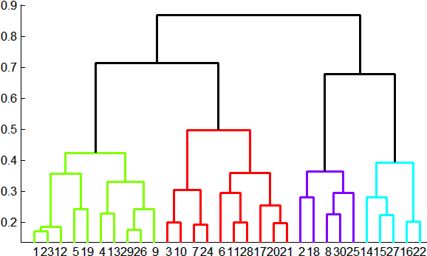
Agglomerative clustering
How to define cluster similarity?
Average distance between points,
maximum distance
minimum distance
Distance between means or medoids
How many clusters?
Clustering creates a dendrogram (a tree)
Threshold based on max number of clusters or based on distance between merges
distance

Slide 32
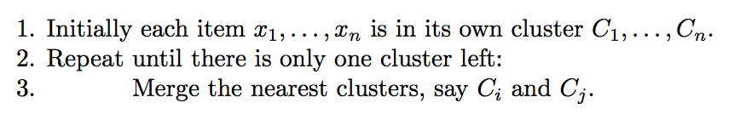
Agglomerative Hierarchical Clustering - Algorithm

Slide 33
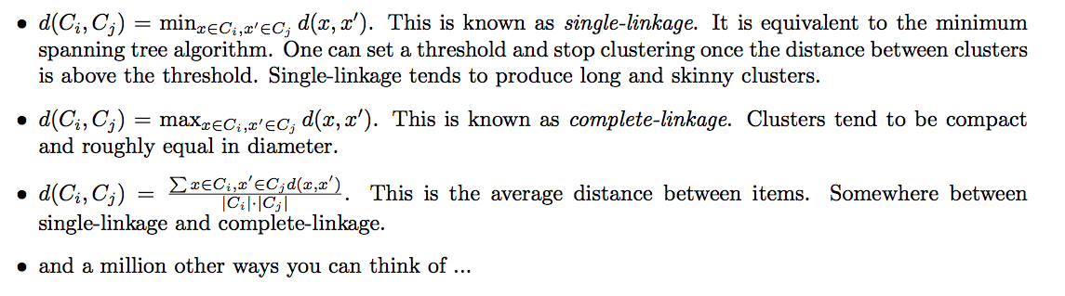
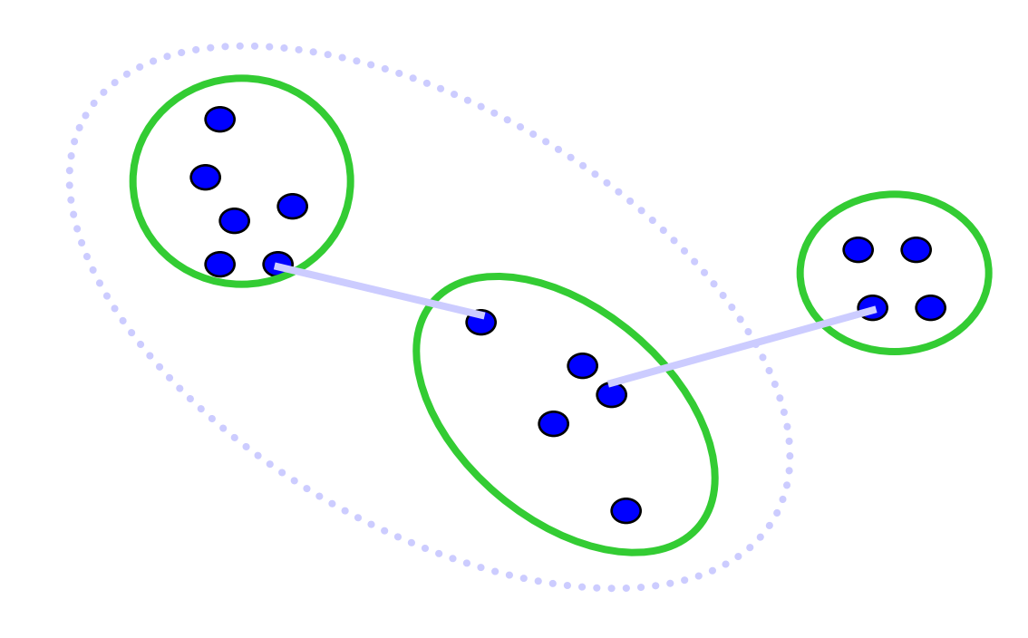
Different measures of nearest clusters
Single Link
Long, skinny clusters

Slide 34
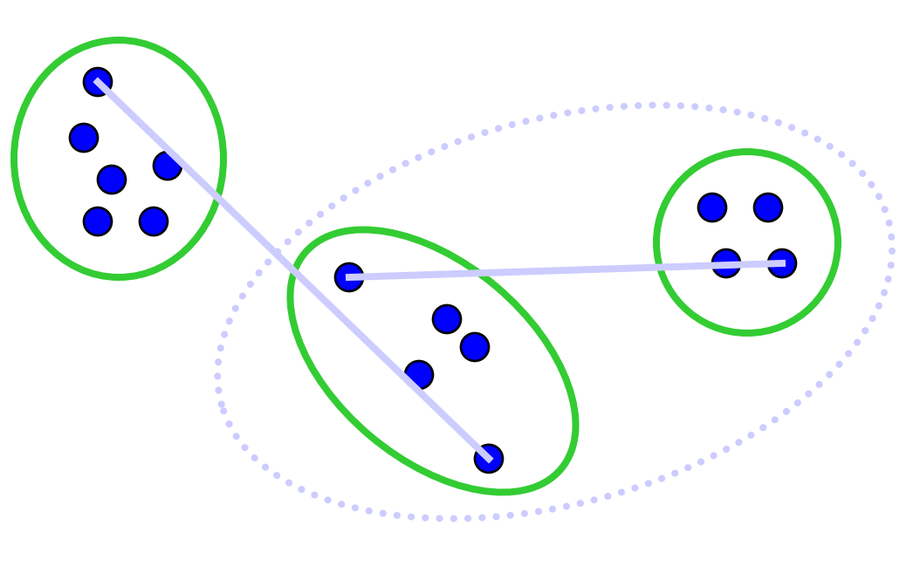
Different measures of nearest clusters
Complete Link
Tight clusters

Slide 35
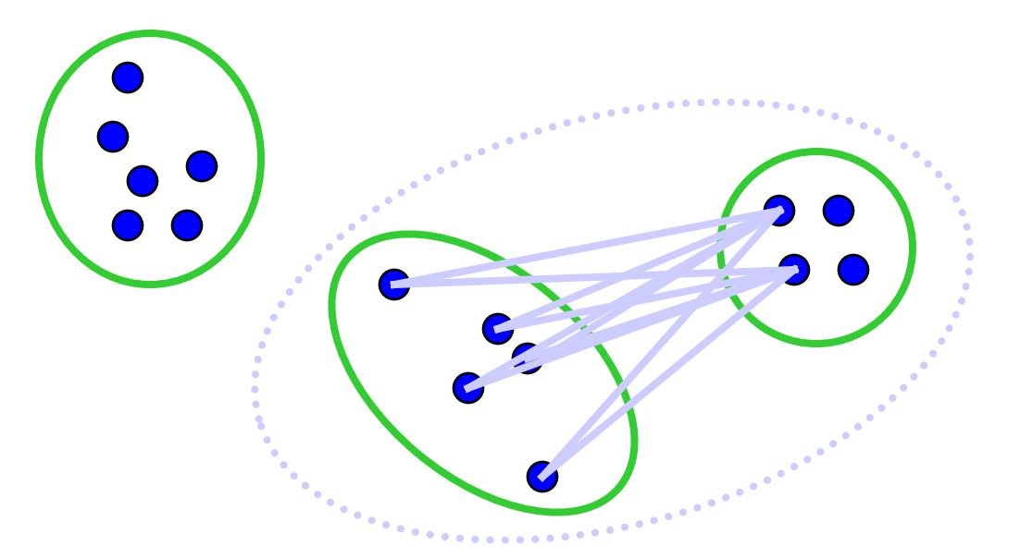
Different measures of nearest clusters
Average Link
Robust against noise.

Slide 36
Conclusions: Agglomerative Clustering
Good
Simple to implement, widespread application.
Clusters have adaptive shapes.
Provides a hierarchy of clusters.
No need to specify number of clusters in advance.
Bad
May have imbalanced clusters.
Still have to choose number of clusters or threshold.
Does not scale well. Runtime of O(n³).
Can get stuck at a local optima.

Slide 37
Segmentation using clustering
Agglomerative Clustering
Kmeans

Slide 38
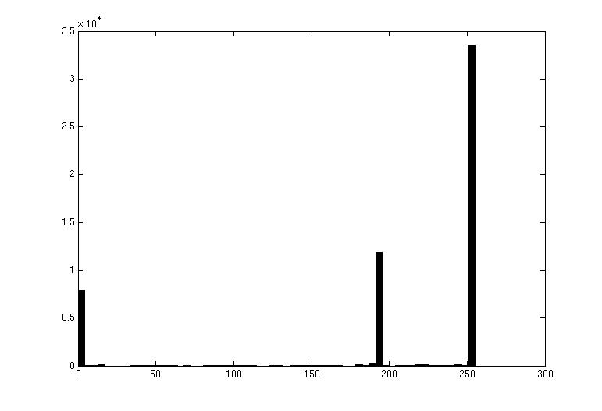
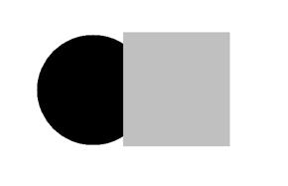
Image Segmentation: Toy Example
These intensities define the three groups.
We could label every pixel in the image according to which of these primary intensities it is.
i.e., segment the image based on the intensity feature.
What if the image isn’t quite so simple?
white pixels
3
black pixels
gray pixels
1
2
input image
intensity
Slide credit: Kristen Grauman

Slide 39
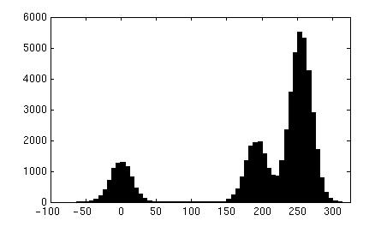

Pixel count
Input image
Intensity
Pixel count
Input image
Intensity
Slide credit: Kristen Grauman

Slide 40
Now how to determine the three main intensities that define our groups?
We need to cluster.
Pixel count
Input image
Intensity
Slide credit: Kristen Grauman

Slide 41
Goal: choose three “centers” as the representative intensities, and label every pixel according to which of these centers it is nearest to.
Best cluster centers are those that minimize Sum of Square Distance (SSD) between all points and their nearest cluster center c_{i}:
0
190
255
Intensity
3
1
2
Slide credit: Kristen Grauman

Slide 42
Clustering for Summarization
Goal: cluster to minimize variance in data given clusters
Preserve information
Cluster center
Data
Whether is assigned to
Slide: Derek Hoiem

Slide 43
Clustering
With this objective, it is a “chicken and egg” problem:
If we knew the cluster centers, we could allocate points to groups by assigning each to its closest center.
If we knew the group memberships, we could get the centers by computing the mean per group.
Slide credit: Kristen Grauman

Slide 44
K-means clustering
Initialize ( ): cluster centers
Compute : assign each point to the closest center
denotes the set of assignment for each to cluster at iteration t
Computer : update cluster centers as the mean of the points
Update , Repeat Step 2-3 till stopped
Slide: Derek Hoiem

Slide 45
K-means clustering
Initialize ( ): cluster centers
Compute : assign each point to the closest center
Computer : update cluster centers as the mean of the points
Update , Repeat Step 2-3 till stopped
Commonly used: random initialization
Or greedily choose K to minimize residual
Typical distance measure:
Euclidean
Cosine
Others
doesn’t change anymore.
Slide: Derek Hoiem

Slide 46
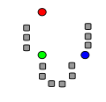
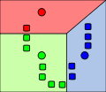
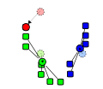
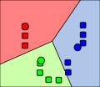
K-means clustering
1. Initialize Cluster Centers
2. Assign Points to Clusters
3. Re-compute Means
Repeat (2) and (3)
Java demo:
http://home.dei.polimi.it/matteucc/Clustering/tutorial_html/AppletKM.html
Illustration Source: wikipedia

Slide 47
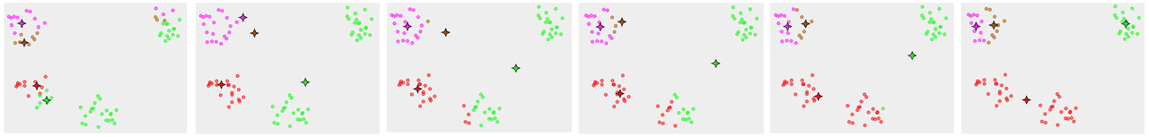
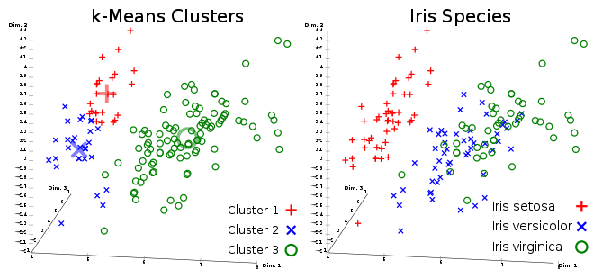
K-means clustering
Converges to a local minimum solution
Initialize multiple runs
Better fit for spherical data
Need to pick K (# of clusters)

Slide 48
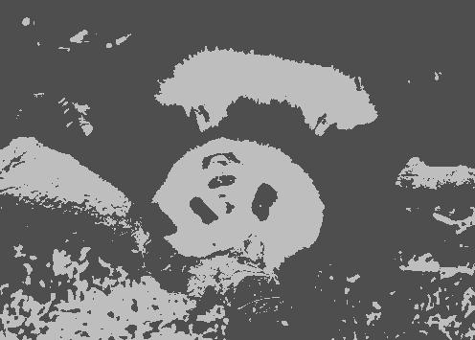


Segmentation as Clustering
2 clusters
Original image
3 clusters

Slide 49
Feature Space
Depending on what we choose as the feature space, we can group pixels in different ways.
Grouping pixels based on intensity similarity
Feature space: intensity value (1D)
Slide credit: Kristen Grauman

Slide 50

Feature Space
Depending on what we choose as the feature space, we can group pixels in different ways.
Grouping pixels based on color similarity
Feature space: color value (3D)
R=255
G=200
B=250
B
G
R=245
G=220
B=248
R
R=15
G=189
B=2
R=3
G=12
B=2
Slide credit: Kristen Grauman

Slide 51

Feature Space
Depending on what we choose as the feature space, we can group pixels in different ways.
Grouping pixels based on texture similarity
Feature space: filter bank responses (e.g., 24D)
F₁
F₂
Filter bank of 24 filters
…
F₂₄
Slide credit: Kristen Grauman

Slide 52

Smoothing Out Cluster Assignments
Assigning a cluster label per pixel may yield outliers:
How can we ensure they are spatially smooth?
Original
Labeled by cluster center’s intensity
?
3
1
2
Slide credit: Kristen Grauman

Slide 53
Segmentation as Clustering
Depending on what we choose as the feature space, we can group pixels in different ways.
Grouping pixels based on intensity+position similarity
⇒ Way to encode both similarity and proximity.
Intensity
Y
X
Slide credit: Kristen Grauman
Notes:
Both regions are black, but if we also include position (x,y), then we could group the two into distinct segments; way to encode both similarity & proximity.

Slide 54



K-Means Clustering Results
K-means clustering based on intensity or color is essentially vector quantization of the image attributes
Clusters don’t have to be spatially coherent
Image
Intensity-based clusters
Color-based clusters
Image source: Forsyth & Ponce

Slide 55





K-Means Clustering Results
K-means clustering based on intensity or color is essentially vector quantization of the image attributes
Clusters don’t have to be spatially coherent
Clustering based on (r,g,b,x,y) values enforces more spatial coherence
Image source: Forsyth & Ponce

Slide 56
How to evaluate clusters?
Generative
How well are points reconstructed from the clusters?
Discriminative
How well do the clusters correspond to labels?
Can we correctly classify which pixels belong to the panda?
Note: unsupervised clustering does not aim to be discriminative as we don’t have the labels.
Slide: Derek Hoiem

Slide 57

How to choose the number of clusters?
Try different numbers of clusters in a validation set and look at performance.
Slide: Derek Hoiem

Slide 58


K-Means pros and cons
Pros
Finds cluster centers that minimize conditional variance (good representation of data)
Simple and fast, Easy to implement
Cons
Need to choose K
Sensitive to outliers
Prone to local minima
All clusters have the same parameters (e.g., distance measure is non-adaptive)
*Can be slow: each iteration is O(KNd) for N d-dimensional points
Usage
Unsupervised clustering
Rarely used for pixel segmentation

